Slide 1
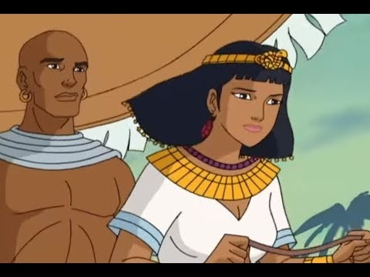
King Solomon

Slide 2
King Solomon - 3rd King of Israel – Asks for Wisdom (2 Chronicles
Bible Summary:
King Solomon was the son of King David. King Solomon wanted to follow God just like his father, King David. So Solomon traveled to Gibion to ask God what he should do.
God appeared to Solomon in a dream and asked Solomon what he wanted. Solomon said he wanted to be wise. God said because he had such a good answer he would give him wisdom. We would be the wisest man in the whole world.
Solomon worked hard to lead his kingdom the way God wanted him to. He was good to his people and made friends with other kingdoms. Because Solomon was so good to his people it made him very rich. He was the richest King in the whole world. He built a huge army with horses and chariots and he built a BEAUTIFUL temple in Jerusalem that was made of GOLD!
Sadly . . .
Solomon did make some mistakes. He made friends with the people that did not love God. He even married the daughters of the Kings that didn’t love God. Solomon’s people, the Israelites started to forget about God too! This made God very sad and Solomon’s kingdom became weak and split up.
Talk: When we spend time with people that love God, we love God even more. When we spend time with people that forget about God, it makes us forget about God too. Who are your people that you count on to help you love God more everyday?
Bible Words: “Give me wisdom and knowledge, that I may lead this people, for who is able to govern this great people of yours.” 2 Chronicles 1:10
Pray: God help us to look to you and to love you and keep the people that love you close to us!
Notes:
This map shows the Kingdom of Israel during the time of Solomon, with pictures of what his beautiful temple may have looked like.
After King David had died, Solomon became the third king of Israel. He inherited the kingdom which extended from the great Euphrates River all the way to the river of Egypt in the South. Solomon wanted to be a man of God like his father, so before he made any decisions he traveled to Gibeon to ask God what he should do as king. While he was there, he had a dream, and the Lord appeared to him and offered him whatever he wanted. Solomon chose wisdom so that he could lead God's great people well. Because Solomon gave God such a great answer, He granted his request and Solomon became the wisest man who had ever lived!
Unlike his father, David, Solomon was not a warrior. He wanted to keep peace throughout the land and develop good relationships with the surrounding kingdoms. Solomon made trade routes, so he could become friends with the other nations and they could help each other. These trade routes did more than make Solomon friends, but they also made him very wealthy! It did not take Solomon very long to become the wealthiest king in the world.
With his wealth, he was able to build a huge army with horses and chariots and a beautiful temple in Jerusalem that was made out of gold! People were amazed by Solomon’s wisdom and his wealth and would travel across the world just to hear his wisdom and see his temple.
Even though Solomon did so much to help the nation of Israel, he did a lot of things that hurt it too. Because he wanted to stay friends with the surrounding nations, Solomon married many foreign kings’ daughters even though the Bible says to have only one wife. Solomon allowed his wives to bring in their false gods to worship, and many of the Israelites started to worship the false gods instead of the one true God. Eventually, the mistakes that Solomon made led to the splitting of Israel into two kingdoms.

Slide 3
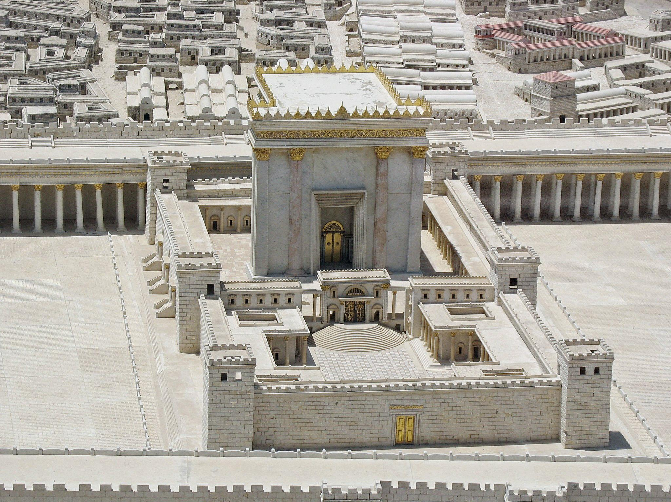
Solomon Built the Temple in Jerusalem

Slide 4
More Resources
Truewaykids.com
Enjoy these extra activities to work on throughout the week!

